Slide 1
SENG 1000 - Software Engineering Foundations and Practice
-Sumati

Slide 2
Topics
Compilers and Interpreters
Using Python
Python Scripts
IDLE
Programming Basics
Understanding the Code
Data Types and comments
Variables & Naming Conventions
Assignment and Operations

Slide 3
Compilers and Interpreters
Programs written in high-level languages must be translated into machine language to be executed
Compiler: translates high-level language program into separate machine language program
Machine language program can be executed at any time

Slide 4
Compilers and Interpreters (cont’d.)
Interpreter: translates and executes instructions in high-level language program
Used by Python language
Interprets one instruction at a time
No separate machine language program
Source code: statements written by programmer
Syntax error: prevents code from being translated

Slide 5
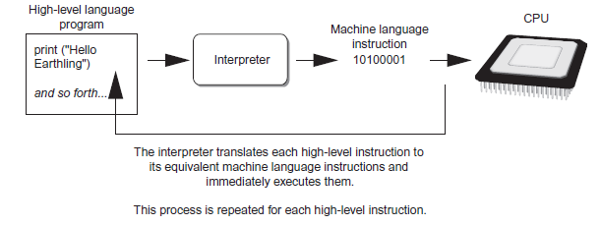
Compilers and Interpreters (cont’d.)
Executing a high-level program with an interpreter

Slide 6
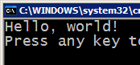



Compiling and interpreting
Many languages require you to compile (translate) your program into a form that the machine understands.
Python is instead directly interpreted into machine instructions.
compile
execute
source code
Hello.java
byte code
Hello.class
output
interpret
source code
Hello.py
output

Slide 7
Using Python
Python must be installed and configured prior to use
One of the items installed is the Python interpreter
Python interpreter can be used in two modes:
Interactive mode: enter statements on keyboard
Script mode: save statements in Python script

Slide 8
Interactive Mode
When you start Python in interactive mode, you will see a prompt
Indicates the interpreter is waiting for a Python statement to be typed
Prompt reappears after previous statement is executed
Error message displayed If you incorrectly type a statement
Good way to learn new parts of Python

Slide 9
Writing Python Programs and Running Them in Script Mode
Statements entered in interactive mode are not saved as a program
To have a program use script mode
Save a set of Python statements in a file
The filename should have the .py extension
To run the file, or script, type
python filename
at the operating system command line

Slide 10
The IDLE Programming Environment
IDLE (Integrated Development Learning Environment): single program that provides tools to write, execute and test a program
Automatically installed when Python language is installed
Runs in interactive mode
Has built-in text editor with features designed to help write Python programs

Slide 11
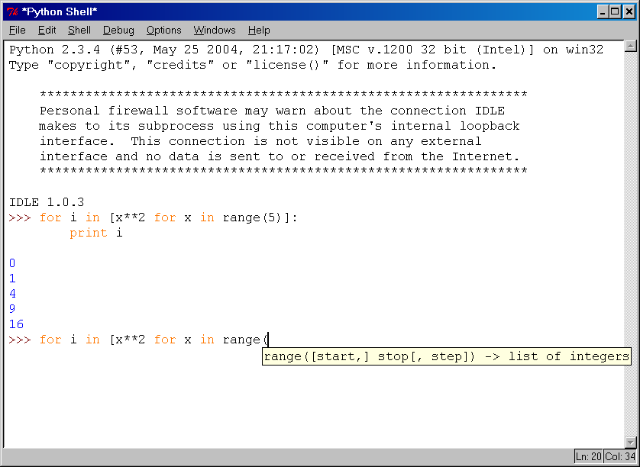
IDLE Development Environment
IDLE is an Integrated DeveLopment Environ-ment for Python, typically used on Windows
Multi-window text editor with syntax highlighting, auto-completion, smart indent and other.
Python shell with syntax highlighting.
Integrated debugger with stepping, persis- tent breakpoints, and call stack visi- bility

Slide 12
Basic Built-in Datatypes
booleans (which have the value True or False)
integers (whole numbers such as 42 and 100000000)
floats (numbers with decimal points such as 3.14159, or sometimes exponents like 1.0e8, which means one times ten to the eighth power, or 100000000.0)
strings (sequences of text characters)

Slide 13
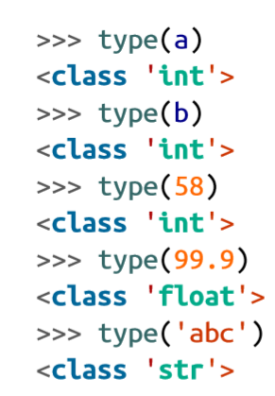
Basic Built-in Datatypes

Slide 14
Base-n literal integers
0b or 0B for binary (base 2).
>>> 0b10 → 2
0o or 0O for octal (base 8).
>>> 0o10 → 8
0x or 0X for hex (base 16).
>>> 0x10 → 16

Slide 15
Type Conversions
To convert from one datatype to other
>>> int(True) → 1
>>> int(False) → 0
>>> int(98.6) →98
>>> int(1.0e4) →10000
>>> float(True) →1.0
>>> float('99’) →99.0

Slide 16
Whitespace
Whitespace is meaningful in Python: especially indentation and placement of newlines
Use a newline to end a line of code
Use \ when must go to next line prematurely
No braces {} to mark blocks of code, use consistent indentation instead
First line with less indentation is outside of the block
First line with more indentation starts a nested block
Colons start of a new block in many constructs, e.g. function definitions, then clauses

Slide 17
Breaking Long Statements into Multiple Lines
Long statements cannot be viewed on screen without scrolling and cannot be printed without cutting off
Multiline continuation character (\): Allows to break a statement into multiple lines
Example:
print(‘my first name is’,\
first_name)

Slide 18
More About Data Output
print function displays line of output
Newline character at end of printed data
Special argument end=‘delimiter’ causes print to place delimiter at end of data instead of newline character
print function uses space as item separator
Special argument sep=‘delimiter’ causes print to use delimiter as item separator
Special characters appearing in string literal
Preceded by backslash (\)
Examples: newline (\n), horizontal tab (\t)
Treated as commands embedded in string
When + operator used on two strings in performs string concatenation
Useful for breaking up a long string literal

Slide 19
Comments
Start comments with #, rest of line is ignored
Can include a “documentation string” as the first line of a new function or class you define
Development environments, debugger, and other tools use it: it’s good style to include one
def fact(n):
“““fact(n) assumes n is a positive integer and returns facorial of n.””” assert(n>0)
if n==1 return 1 else n*fact(n-1)

Slide 20
Variables
A Python variable is a reserved memory location to store values.
These are names that refer to values in the computer’s memory that you can define for use with your program.
In other words, a variable in a python program gives data to the computer for processing.

Slide 21
Variable Naming Conventions
Variable names can only contain these characters:
Lowercase letters (a through z)
Uppercase letters (A through Z)
Digits (0 through 9)
Underscore (_)
Names are case sensitive and cannot start with a number.
Names cannot begin with a digit. Also, Python treats names that begin with an underscore in special ways.

Slide 22
Naming Conventions
The Python community has these recommend-ed naming conventions
joined_lower for functions, methods and, attributes
joined_lower or ALL_CAPS for constants
StudlyCaps for classes
camelCase only to conform to pre-existing conventions
Attributes: interface, _internal, __private
Garbage collection: removal of values that are no longer referenced by variables
Carried out by Python interpreter

Slide 23
Valid Variable Names
a
a1
a_b_c___95
_abc
_1
Bob
Bob
_bob
_2_bob_
bob_2
BoB
Invalid Variable Names
1
1a
1_

Slide 24
Accessing Non-Existent Name
Accessing a name before it’s been properly created (by placing it on the left side of an assignment), raises an error
>>> y
Traceback (most recent call last):
File "<pyshell#16>", line 1, in -toplevel-
y
NameError: name ‘y' is not defined
>>> y = 3
>>> y
3

Slide 25
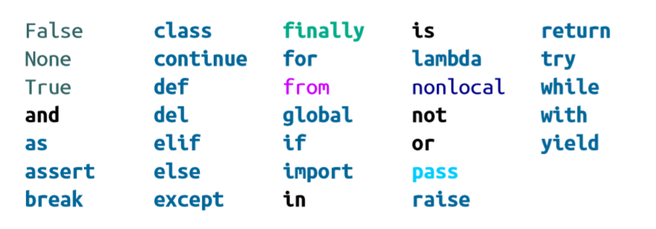
Python’s Reserved Words

Slide 26
Assignment
Binding a variable in Python means setting a name to hold a reference to some object
Assignment creates references, not copies
Names in Python do not have an intrinsic type, objects have types
Python determines the type of the reference automatically based on what data is assigned to it
You create a name the first time it appears on the left side of an assignment expression: x = 3
A reference is deleted via garbage collection after any names bound to it have passed out of scope
Python uses reference semantics (more later)

Slide 27
Assignment
You can assign to multiple names at the same time
>>> x, y = 2, 3
>>> x
2
>>> y
3
This makes it easy to swap values
>>> x, y = y, x
Assignments can be chained
>>> a = b = x = 2

Slide 28
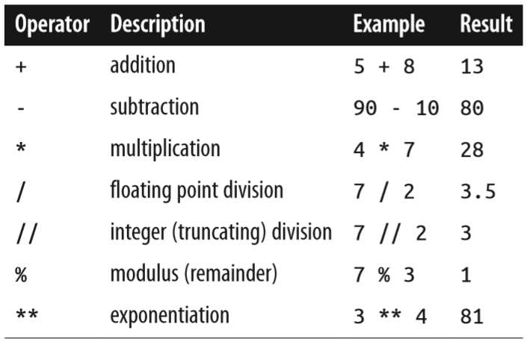
Operators

Slide 29
Expressions
Expression: A data value or set of operations to compute a value.
Examples: 1 + 4 * 3
42
Arithmetic operators we will use:
+ - * / addition, subtraction/negation, multiplication, division
% modulus, a.k.a. remainder
** exponentiation
Precedence: Order in which operations are computed.
* / % ** have a higher precedence than + - 1 + 3 * 4 is 13
Parentheses can be used to force a certain order of evaluation. (1 + 3) * 4 is 16

Slide 30
Mixed-Type Expressions and Data Type Conversion
Data type resulting from math operation depends on data types of operands
Two int values: result is an int
Two float values: result is a float
int and float: int temporarily converted to float, result of the operation is a float
Mixed-type expression
Type conversion of float to int causes truncation of fractional part
Example:
>>> 4 + 7.0 →11.0
>>> True + 2 → 3

Slide 31
Boolean Operations — and, or, not
Comparisons Operations
Operation
x or y
x and y
not x
Operation | Meaning
< | strictly less than
<= | less than or equal
> | strictly greater than
>= | greater than or equal
== | equal
!= | not equal
is | object identity
is not | negated object identity

Slide 32
Numeric Types — int, float
Operation | Result
x + y | sum of x and y
x - y | difference of x and y
x * y | product of x and y
x / y | quotient of x and y
x // y | floored quotient of x and y
x % y | remainder of x / y
-x | x negated
+x | x unchanged
abs(x) | absolute value or magnitude of x
int(x) | x converted to integer
float(x) | x converted to floating point
divmod(x, y) | the pair (x // y, x % y)
pow(x, y) | x to the power y
x ** y | x to the power y

Slide 33
Math commands
Python has useful commands for performing calculations.
To use many of these commands, you must write the following at the top of your Python program:
from math import *
Command name | Description
abs(value) | absolute value
ceil(value) | rounds up
cos(value) | cosine, in radians
floor(value) | rounds down
log(value) | logarithm, base e
log10(value) | logarithm, base 10
max(value1, value2) | larger of two values
min(value1, value2) | smaller of two values
round(value) | nearest whole number
sin(value) | sine, in radians
sqrt(value) | square root
Constant | Description
e | 2.7182818...
pi | 3.1415926...

